Slide 1

Climate Justice Now
Short Slide Deck

Slide 2
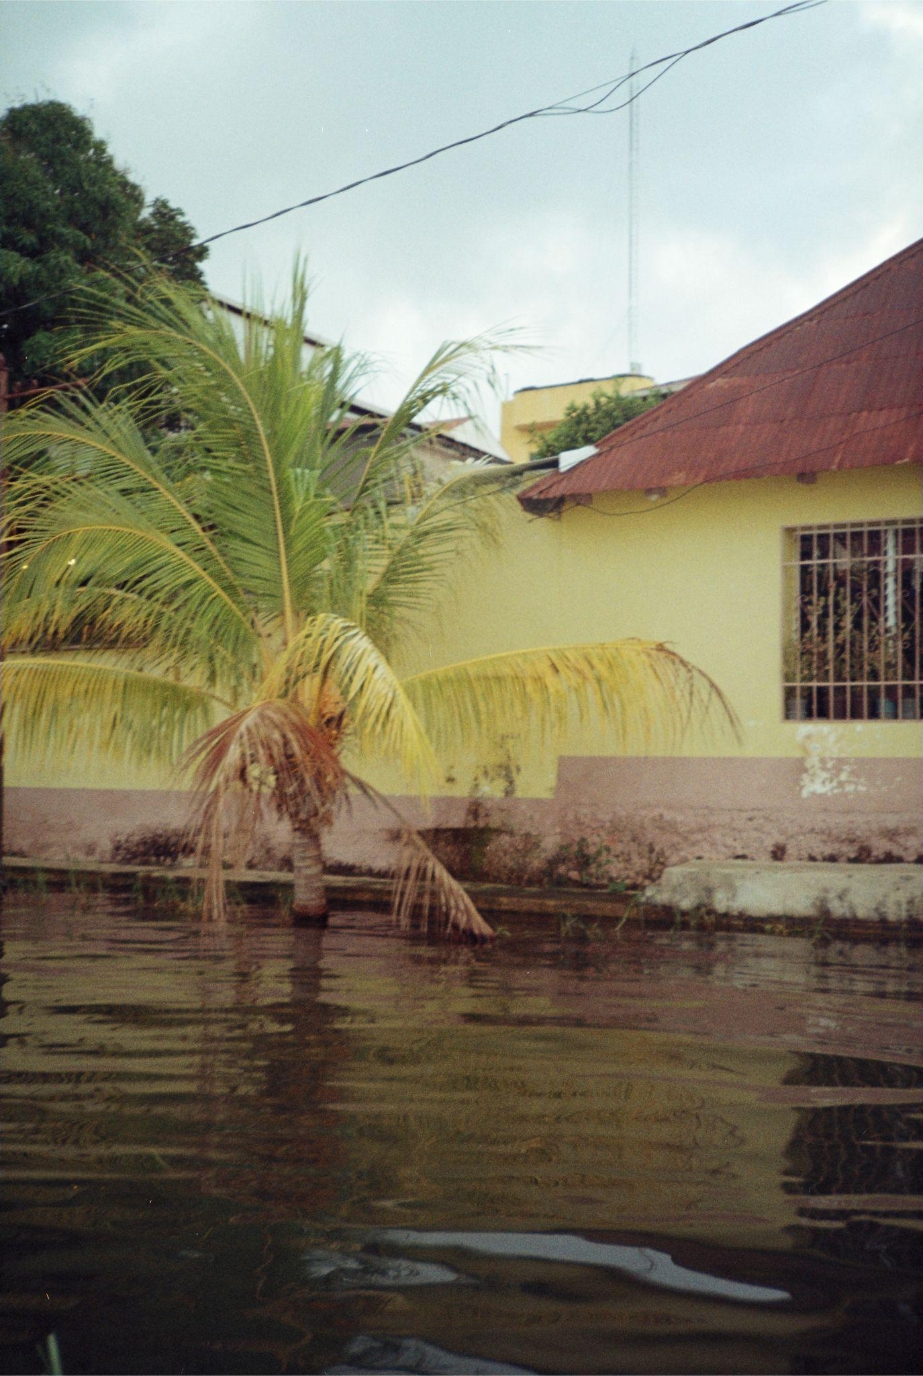

Impacts of Climate Change
Environmental impacts
Human Impacts
Climate events
Floods and Mudslides
Wildfires
Drought
Extreme Weather
Long term changes
Ocean Acidification
Soil and Crop Damage
Sea Level Rise
Melting Glaciers
Ecosystem Loss
Species Extinction
Famine
Water Scarcity
Infrastructure Loss
Climate Migration (Refugees)
Public Health
Political Instability
Threat to the Global Economy
Photo: Jessica Besch

Slide 3
What do we mean by Climate Justice?
“…links human rights and development to achieve a human-centred approach, safeguarding the rights of the most vulnerable people and sharing the burdens and benefits of climate change and its impacts equitably and fairly”.
Source: Mary Robinson Foundation
“Climate justice means holding accountable the countries, corporations, and people fueling our climate crisis and demanding they support those experiencing its harshest effects. “
Source: Oxfam International

Slide 4
Why does climate injustice arise?
Past
Present
Historical injustices e.g.
Colonisation
Land theft
Resource extraction
Future
Current inequalities e.g.
Poverty
Racism
Gender discrimination
Political views and policies
Unfair impacts of both:
Climate (in)actions
Climate solutions
Climate change deepens existing inequalities
Intersectionality means that people's experiences are shaped by multiple identities
Understanding intersectionality helps us design fairer solutions that don't leave anyone behind

Slide 5
Intersectionality: Where Systems and Identities Meet
“Intersectionality is a metaphor for understanding the ways that multiple forms of inequality or disadvantage sometimes compound themselves and create obstacles that often are not understood among conventional ways of thinking”
Kimberlé Crenshaw
Climate risk is shaped by:
Multiple social identities (e.g. location, gender, age, ability)
Social, environmental, and political systems

Slide 6
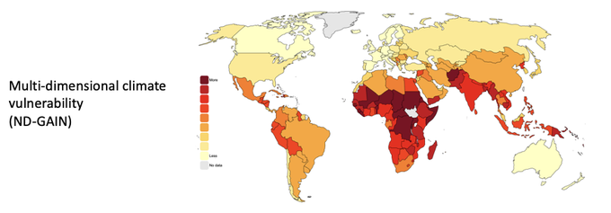
Climate Vulnerability as Global Problem
Between 3.3 and 3.6 billion people live in areas where they are highly vulnerable to climate change, but vulnerability varies based on factors including inequity, marginalization and colonialism (IPCC, AR6, 2023).
Source: Notre Dame Global Adaptation Initiative

Slide 7
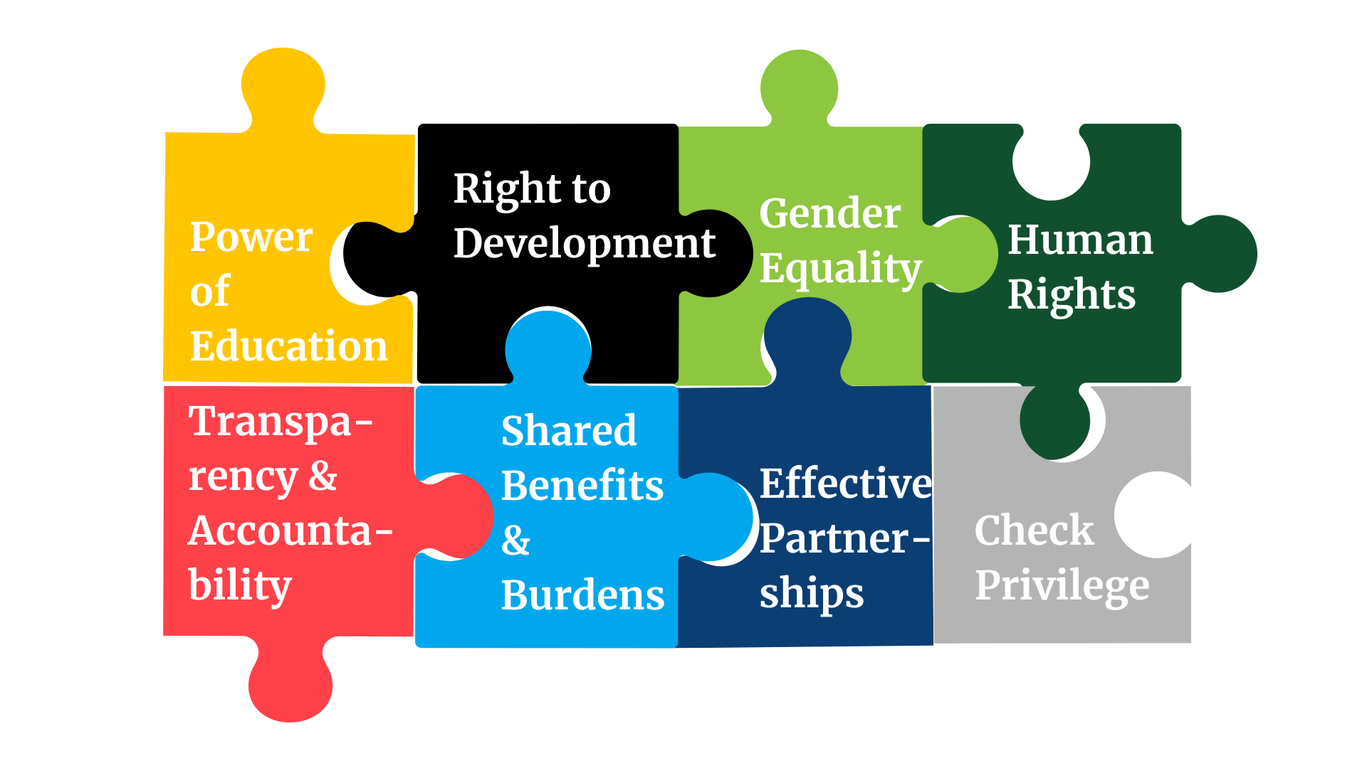
Principles of Climate Justice

Slide 8
Call to Action
ADVOCATE
Sign petitions prioritizing equity and justice in climate action
Call on your bank to stop funding fossil fuel projects that harm frontline communities
Campaign for people-centred and just climate policies
SUPPORT
Contribute to climate justice organizations and movements
Volunteer and participate in local and global climate justice efforts
Engage with your local community
S
E
A
EDUCATE
Inform others about the intersectional impacts of climate change
Promote education on sustainable practices and climate resilience
Use your platform to amplify the voices of impacted communities

Slide 9
Next Steps
If you want to connect to your closest Climate Hub, please send in your request here.
If you want to join our next annual 2-week climate justice training, sign up here to be informed about the application process.
For more updates and opportunities sign-up for our monthly newsletter here.

Slide 10
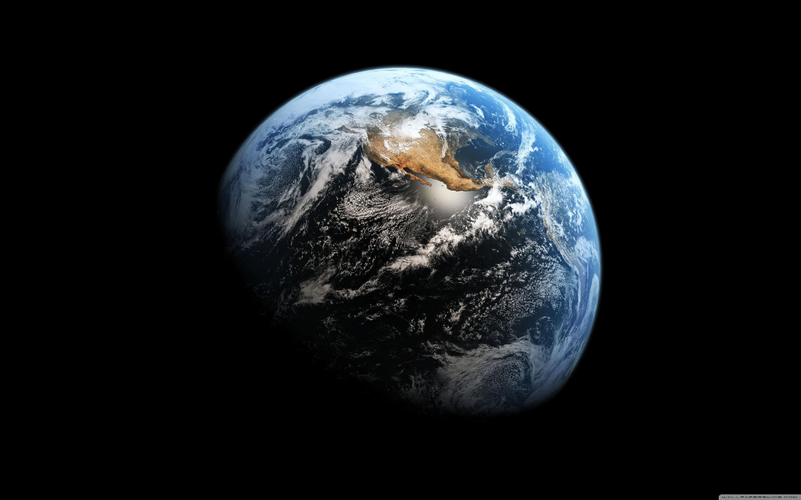
WE MUST, WE CAN,
WE WILL CHANGE!

